Slide 1
HCM Expert Coaching/Consulting
101

Slide 2
Marketing Context
Avatar (To Whom)
Concerns (Chronic vs. Acute)
Benefits
Cultural Sensitivity
Measure and test
Frequency of Communication

Slide 3
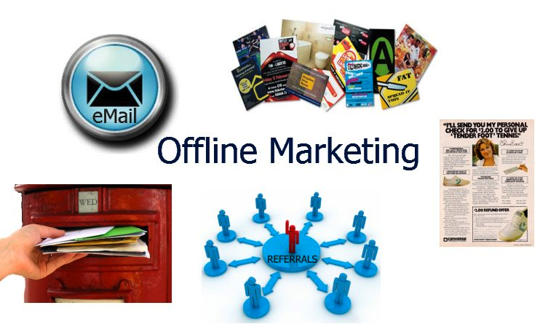
Offline
Networking
Speaking
Referrals
Snail Mail
Post Cards
Hand-written Notes
Telemarketing
800 Numbers
Newspapers
Radio/TV
List Brokers

Slide 4
Networking
Find yourself a John O’Dell
Phone/Meet with Referral Sources
Chamber of Commerce
Greater Houston Partnership
Live Strategic Forums
Texas Diversity Council
Meet ups (Create your own)

Slide 5
Speaking
Make a list of your Expert Topics
Label them in an Engaging manner
Write up your outline for each
List the Take-Aways
Stand up, Speak out & Win
Toastmasters for practice and networking
Offer a Mini-Training add on for a price

Slide 6
Referrals
List all referral sources
Systems for keeping track (Rolodex)
Family, Friends, Colleagues, Clients
Asking for Referrals is an Art form
The time to ask is after a substantial win or successful completion of your work
Ask for one referral at a time
Suggest that they call to introduce you
Get a List of Testimonials for your marketing

Slide 7
Online
Email
Website
Blogging
Facebook
Twitter
Forums
Groups
JV

Slide 8
Email
The number one way to communicate on this planet
This too, done correctly, is an Art form
Main challenge is to get your email message opened amidst all of the others
Stand out, engaging subject lines are necessary
Also you want your message to have sub-titles
Use conversational language
People do not so much read them as skim them

Slide 9
Website
Websites used to be online brochures
You want simple pages with calls to action
Now they
Speak to your credibility
Give out information without having to print it
Educate
Collect interested parties on your list
Update them on what they want to hear about
There are four must-have pages and a certain content that works best in a special format

Slide 10
Blogging
Says who you are in terms of your mission
Informs you avatars and interested people of what is current in your thinking and acting
Works best with the Strategy of Preeminence
Attracts comments that tell you whether you are on track and what they would like more of
Gives you a bigger voice in the world
Allows you to serve them whether or not they become clients or customers

Slide 11
Facebook & Twitter
If you do not have a business presence on each of these, now is a good time to start
FB advertising is being used to sell thousands of products and services
Twitter is a great way to get fast feedback on almost any subject
FB also allows you to get your message out, attract clients and serve your market

Slide 12
Individual vs. Group Sessions
One on One is great modality to go deep
Develops great relationships for referrals
Move faster in a totally customized approach
Message/Mission is communicated to more people faster
Group support each other
Groups will continue on

Slide 13
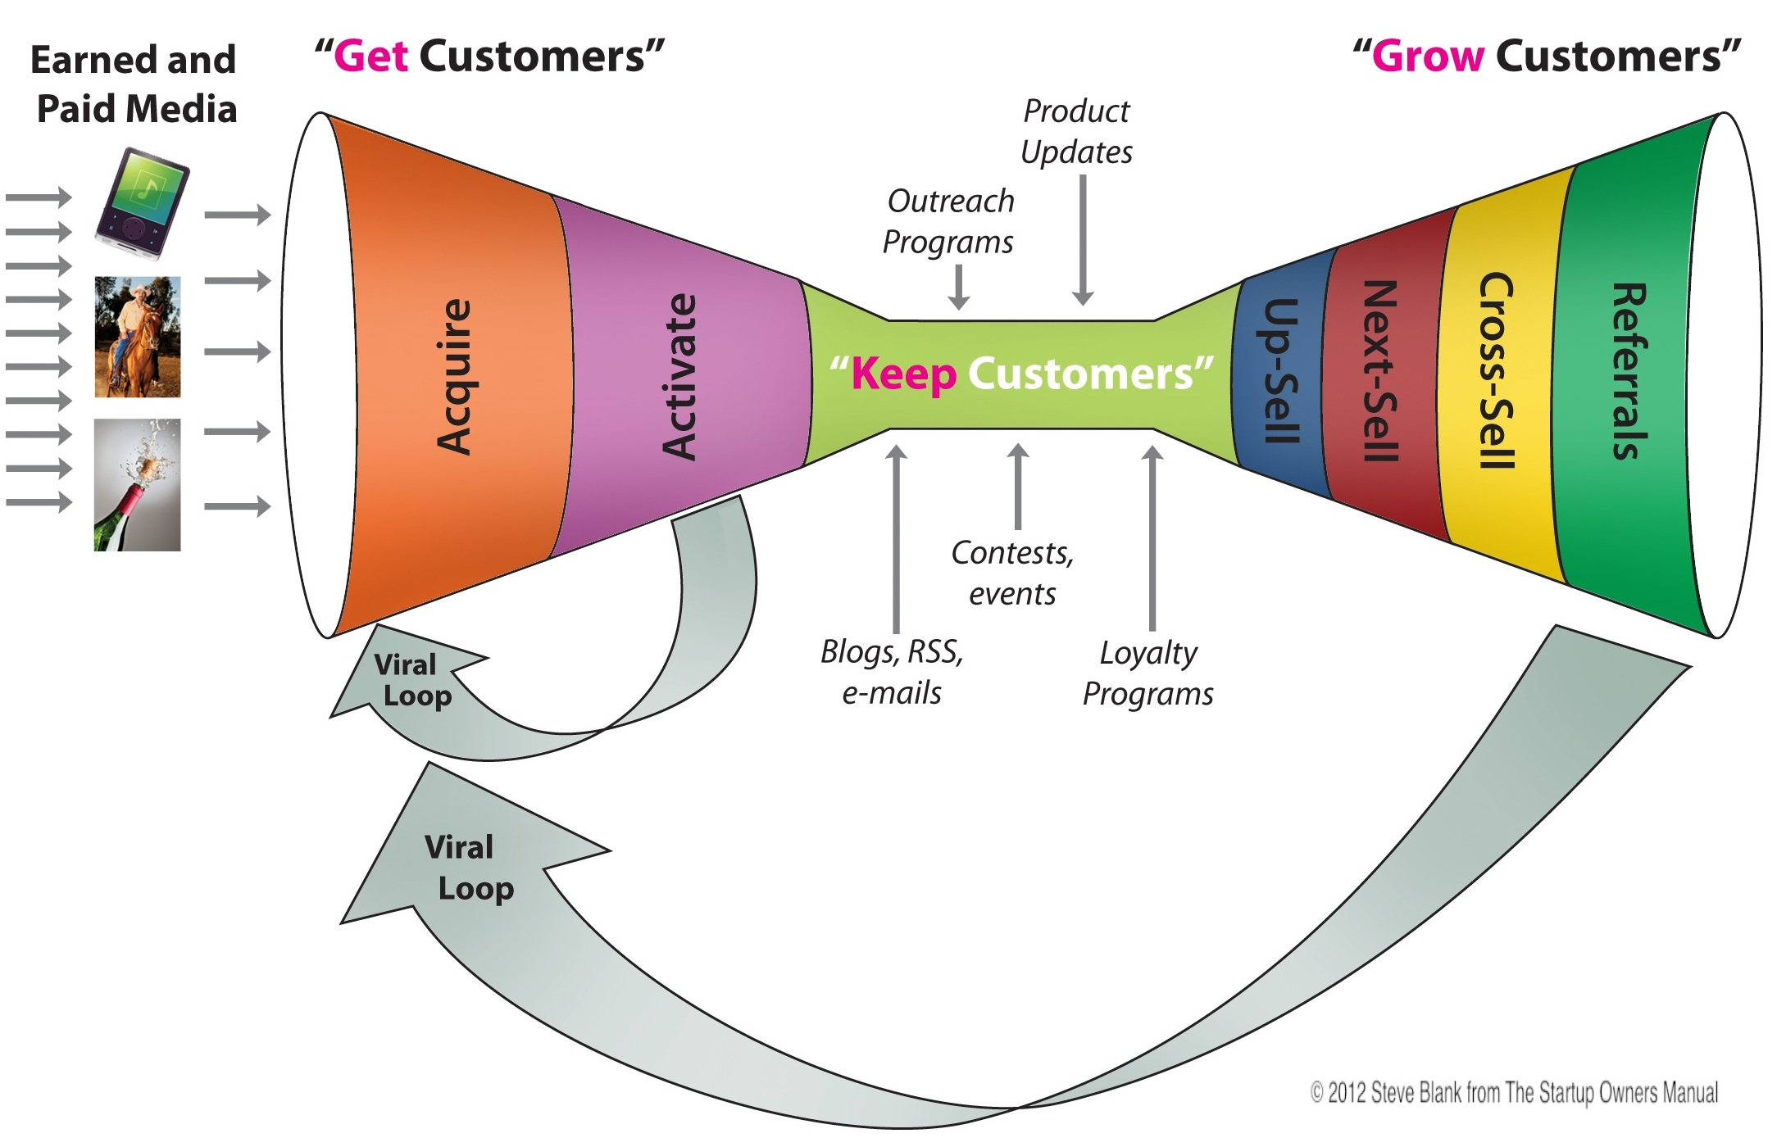
Simple Start Marketing Funnels

Slide 14
Resource Guide (Pics & Links)
AWeber
Andre Chaperon
BlogMarketingAcademy
Online Marketing Mastery
HCM Continuing Education
Facebook Lead Generation

Slide 15
Resource Guide Cont.
Domain Names
Hosting
WordPress Instruction
Fiverr
Codeable
Vimeo
FreeConferenceCall.com

Slide 16
Get Started!
Whatever you wish to do,
Begin It!
Momentum has Boldness and
Magic within it!

Slide 17
Monthly Continuity Program
If…
You could have a new dynamic coaching tool each month
You could hear successful tips and stories from high performers in coaching, consulting & marketing
You could ask your questions about your client sessions and have them answered by experts
You could have all this at a low monthly fee and have it all recorded for future playback
Then…

Slide 18
New Coaching Business Checklist
See Video Three

